Slide 1

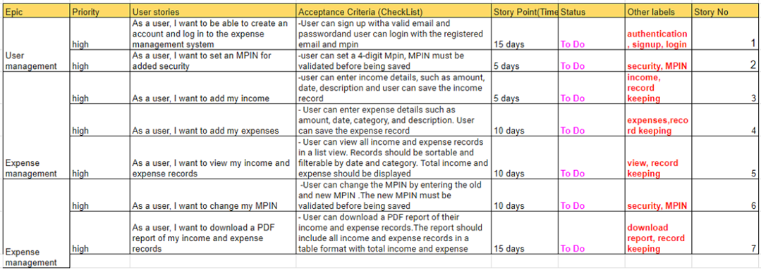
KHARCHA SAATHI
FRONT-END DEVELOPER
Nayan Raj Khanal
2227486
Product Backlog

Slide 2






KHARCHA SAATHI
FRONT-END DEVELOPER
Nayan Raj Khanal
2227486
Technologies Used:

Slide 3

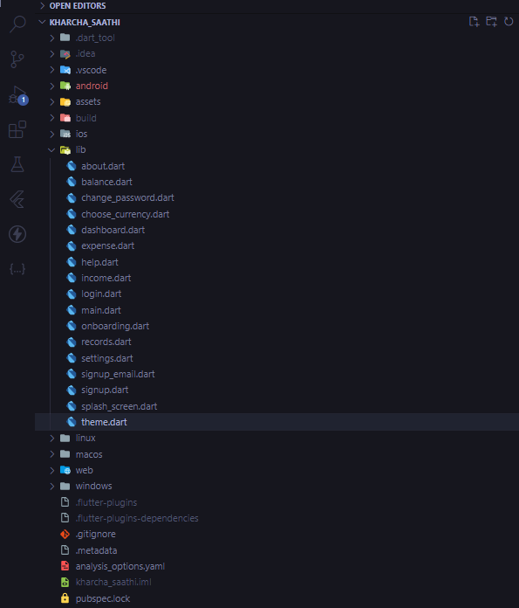
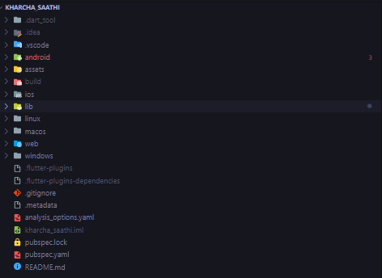
KHARCHA SAATHI
FRONT-END DEVELOPER
Nayan Raj Khanal
2227486
Dart Files

Slide 4
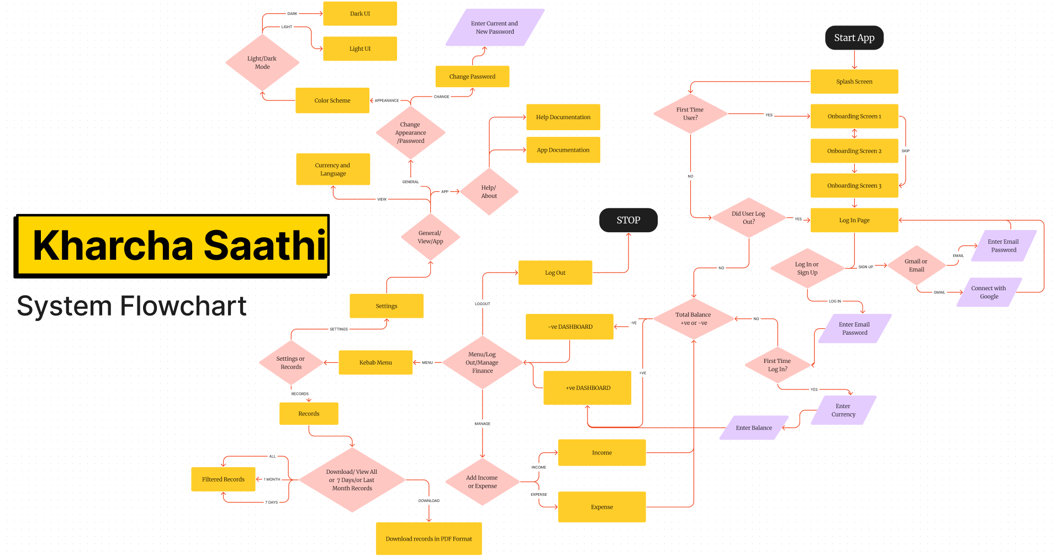
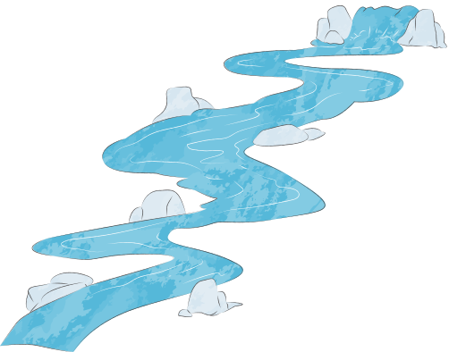
KHARCHA SAATHI
FRONT-END DEVELOPER
Nayan Raj Khanal
2227486

Slide 5
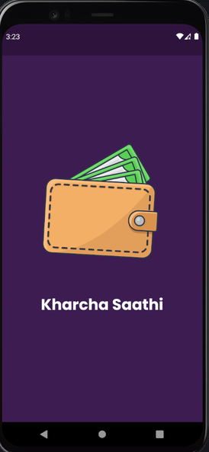
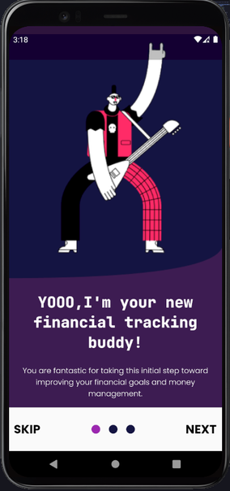
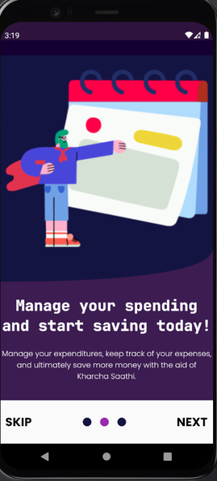
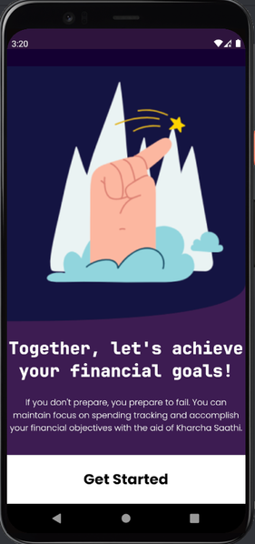
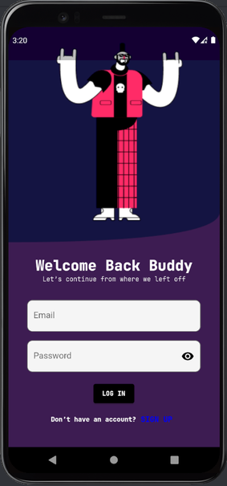
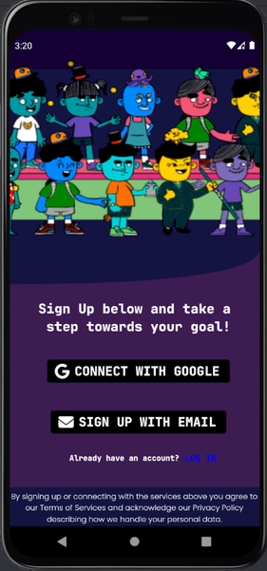
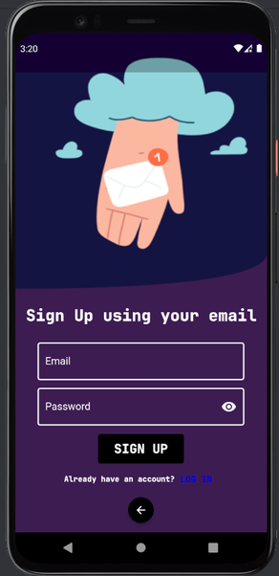

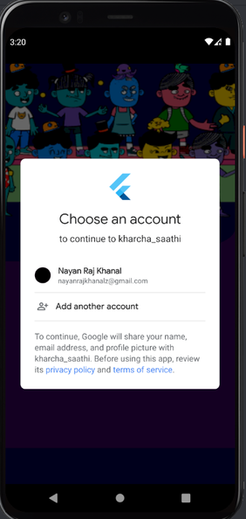
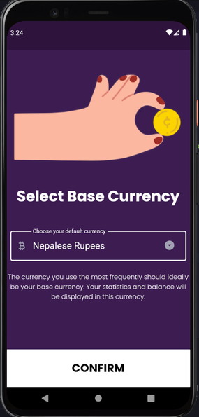
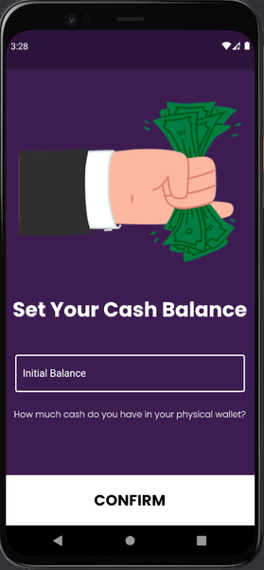
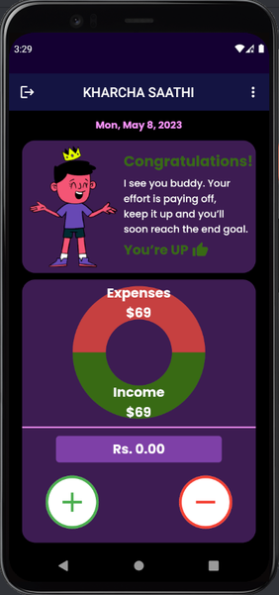
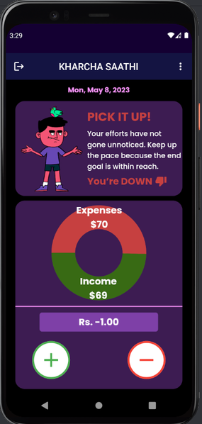
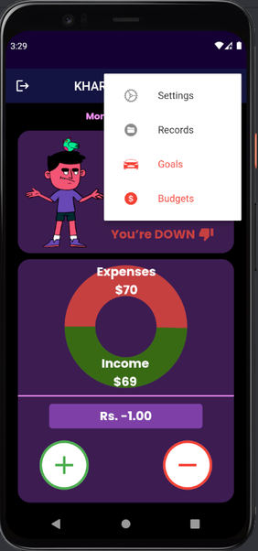
KHARCHA SAATHI
FRONT-END DEVELOPER
Nayan Raj Khanal
2227486
KeyFrames

Slide 6
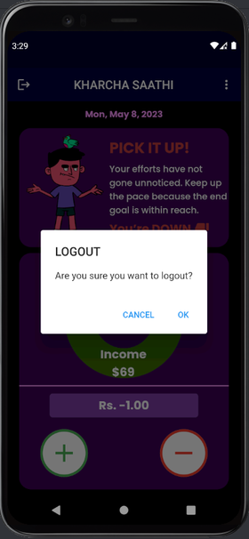
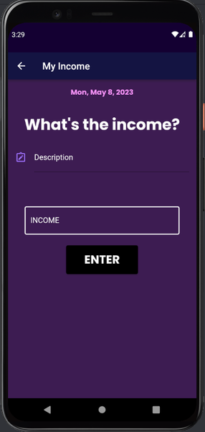
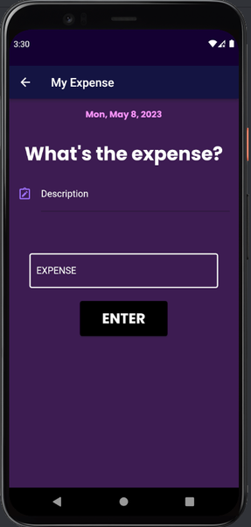
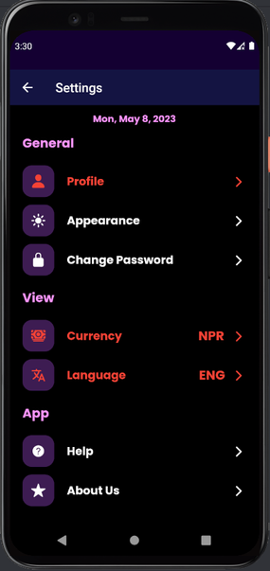
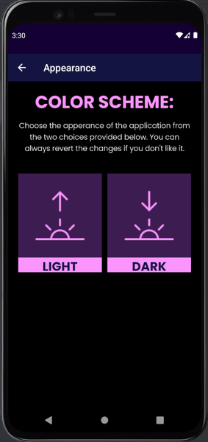
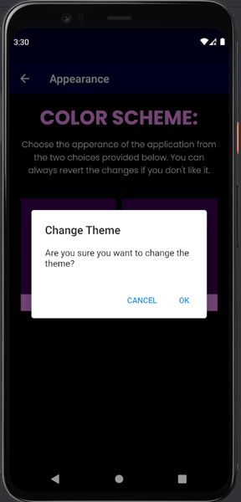
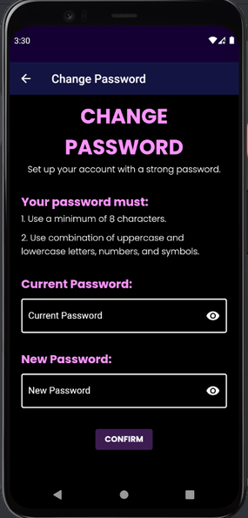

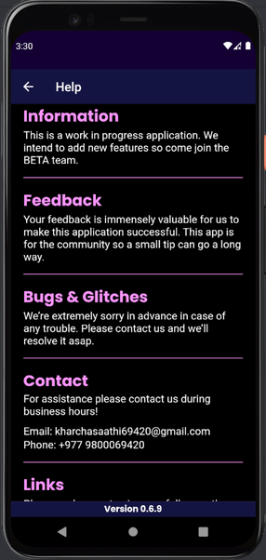
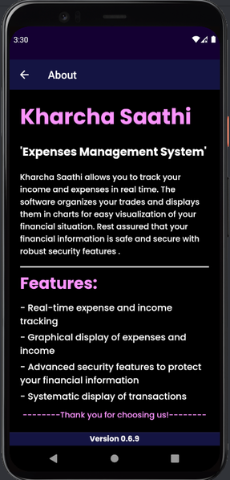
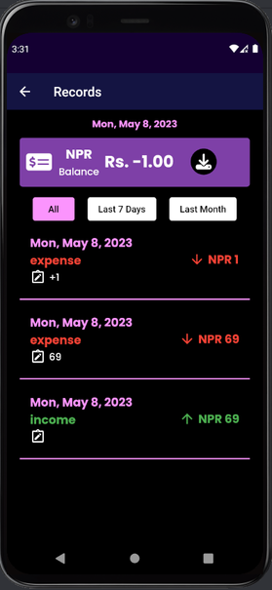
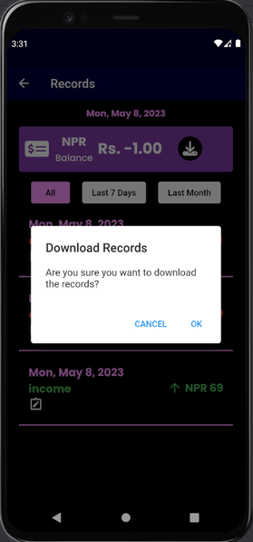
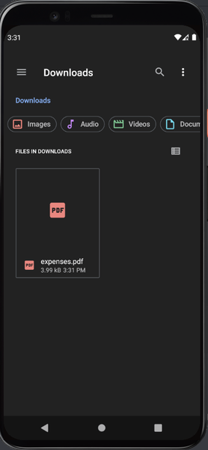
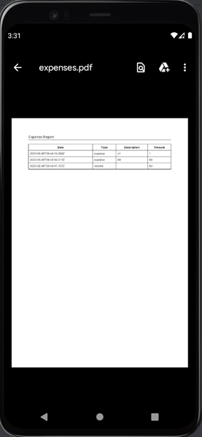
KHARCHA SAATHI
FRONT-END DEVELOPER
Nayan Raj Khanal
2227486
KeyFrames

Slide 7
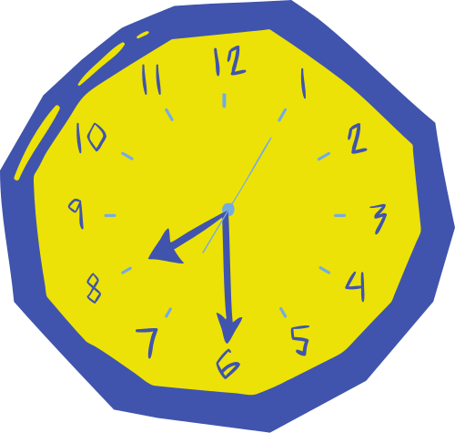
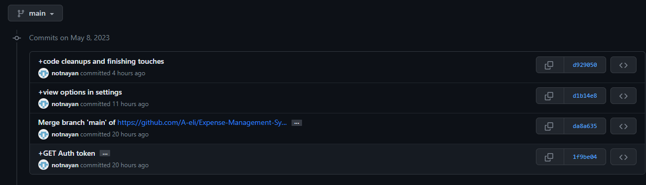
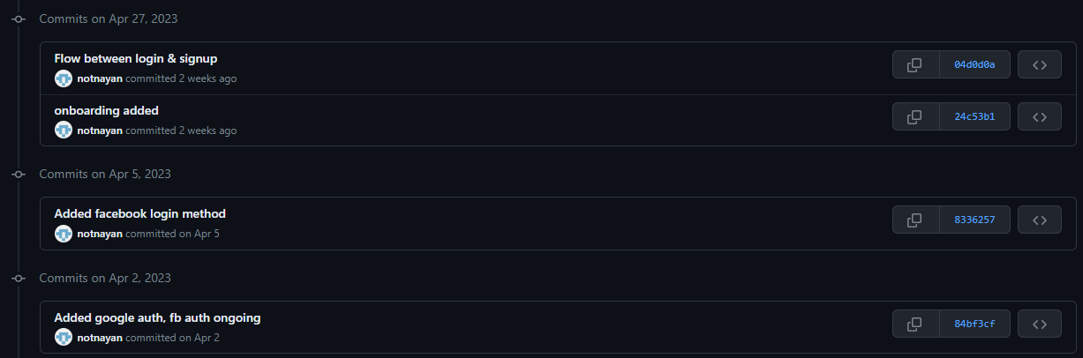
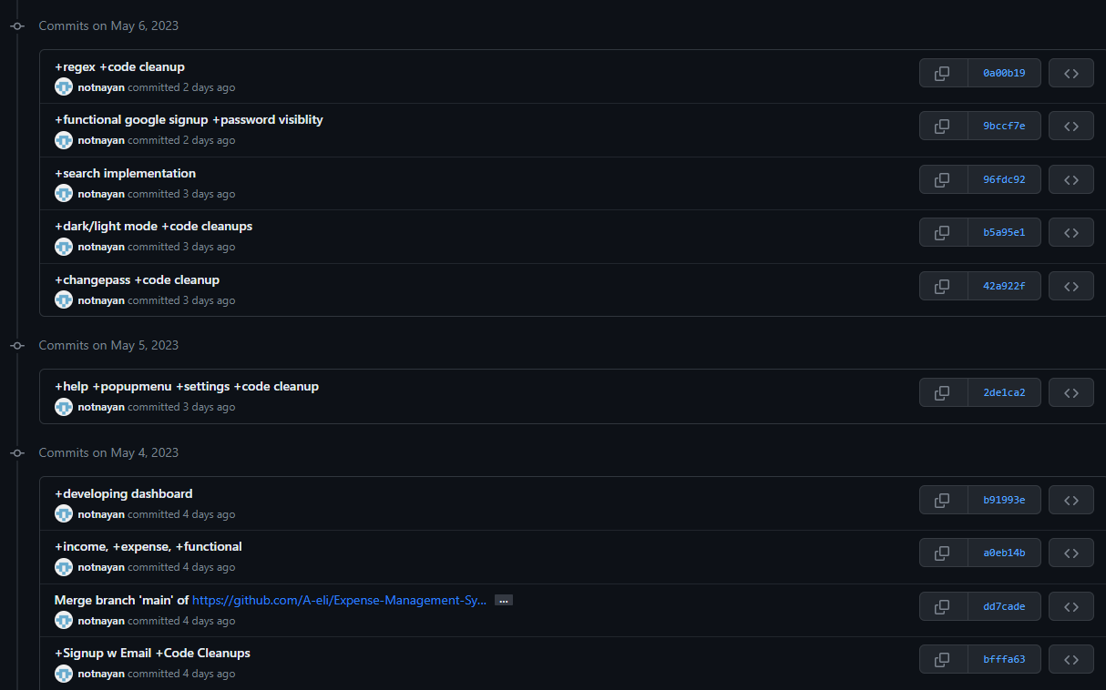
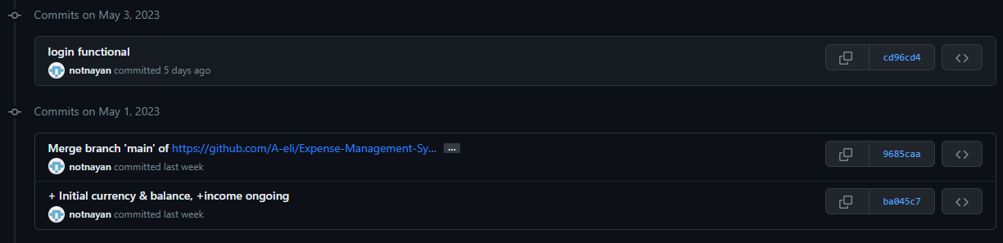
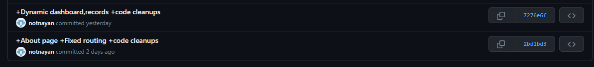
KHARCHA SAATHI
FRONT-END DEVELOPER
Nayan Raj Khanal
2227486
Commits

Slide 8
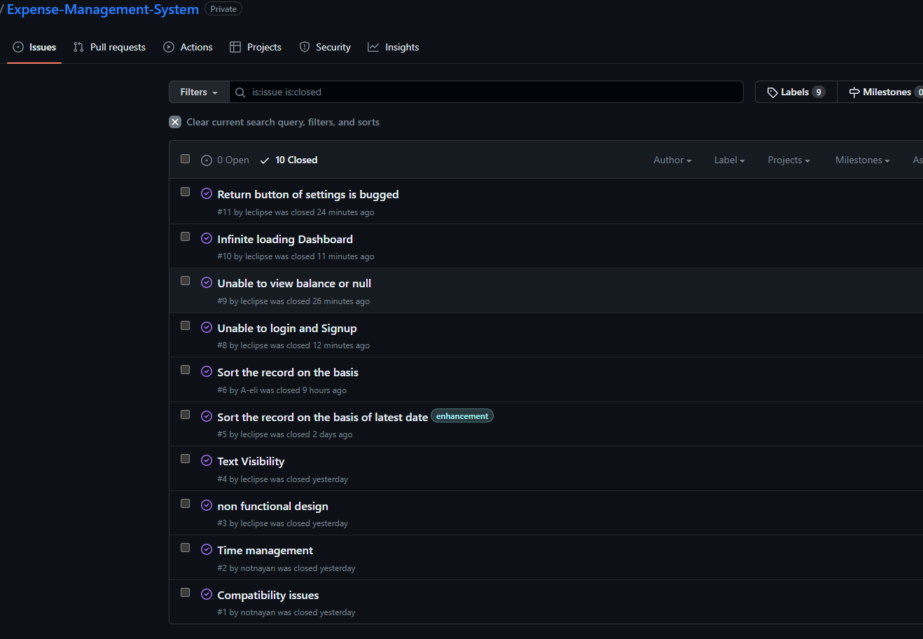

KHARCHA SAATHI
FRONT-END DEVELOPER
Nayan Raj Khanal
2227486
Issue Tracking

Slide 9
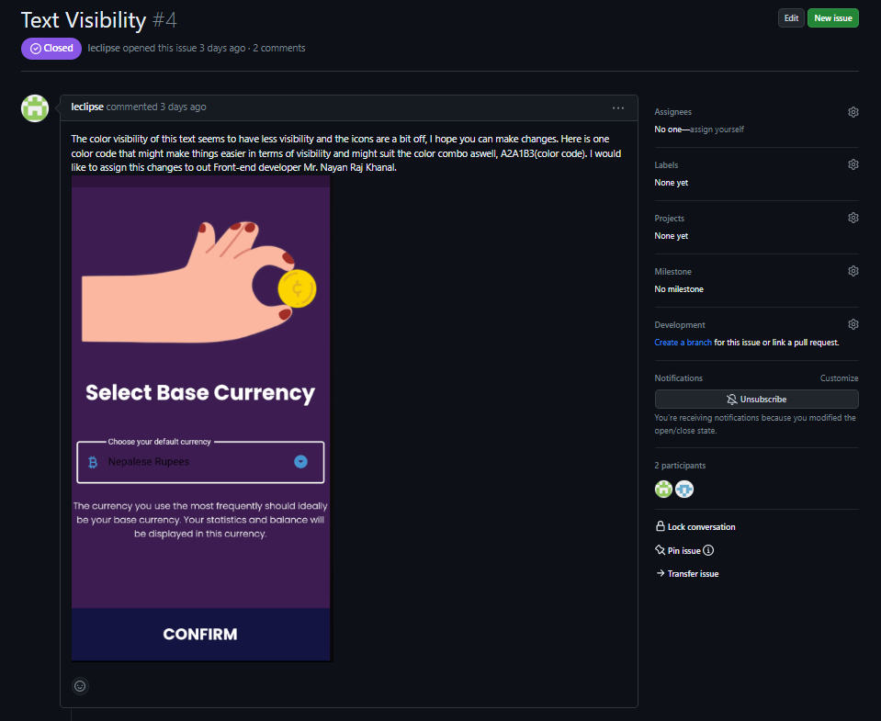
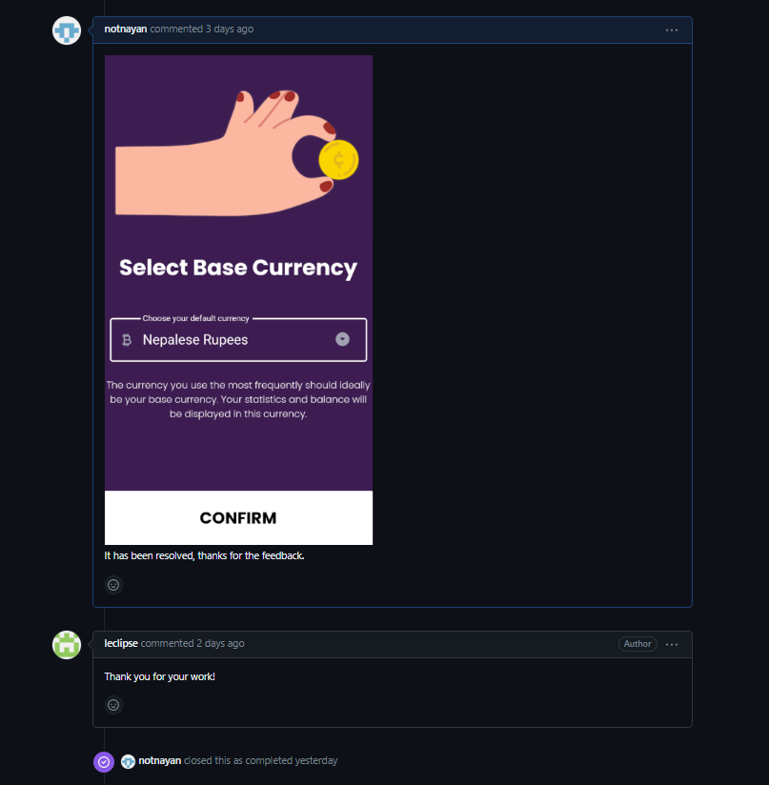
KHARCHA SAATHI
FRONT-END DEVELOPER
Nayan Raj Khanal
2227486
Issue-1

Slide 10
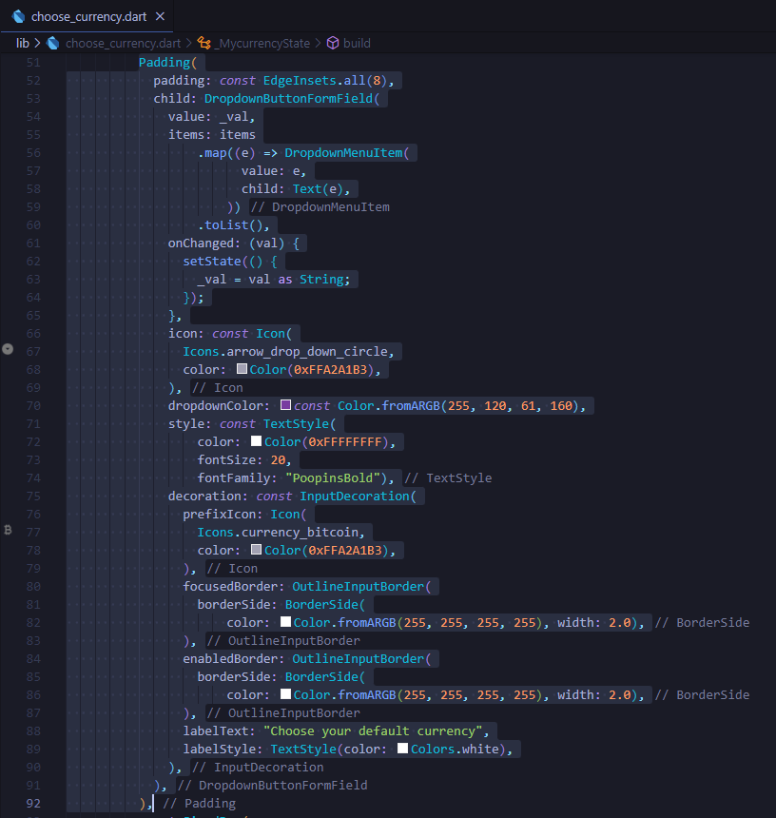

KHARCHA SAATHI
FRONT-END DEVELOPER
Nayan Raj Khanal
2227486
-Changed the icon, input text, and button color for better visibility

Slide 11
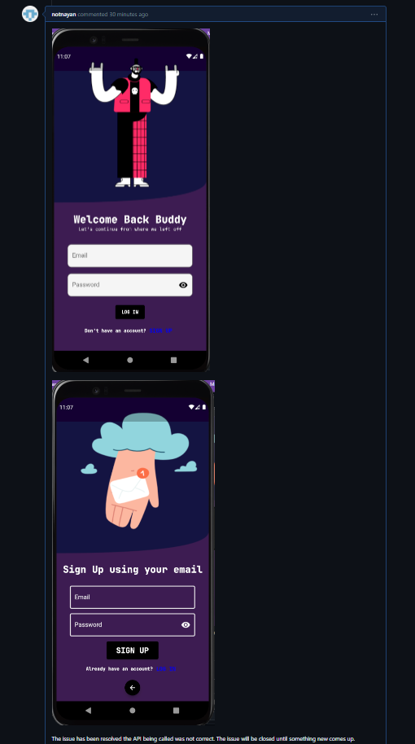
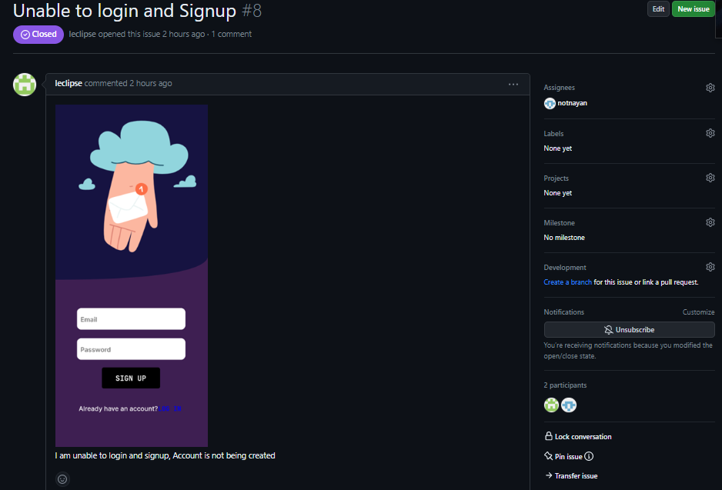
KHARCHA SAATHI
FRONT-END DEVELOPER
Nayan Raj Khanal
2227486
Issue-2

Slide 12
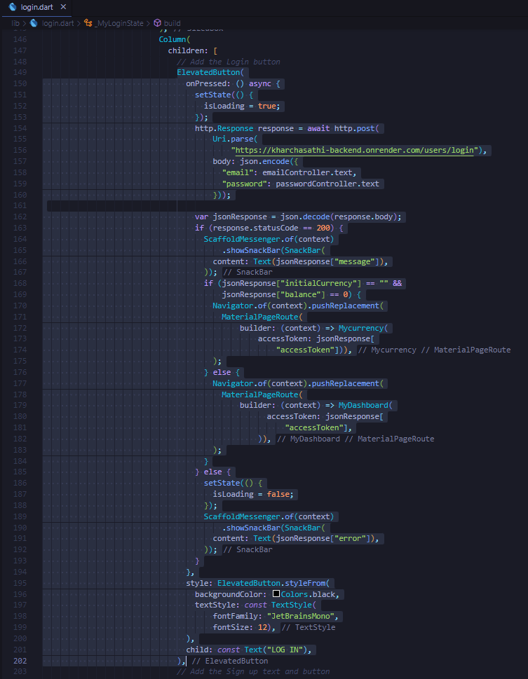
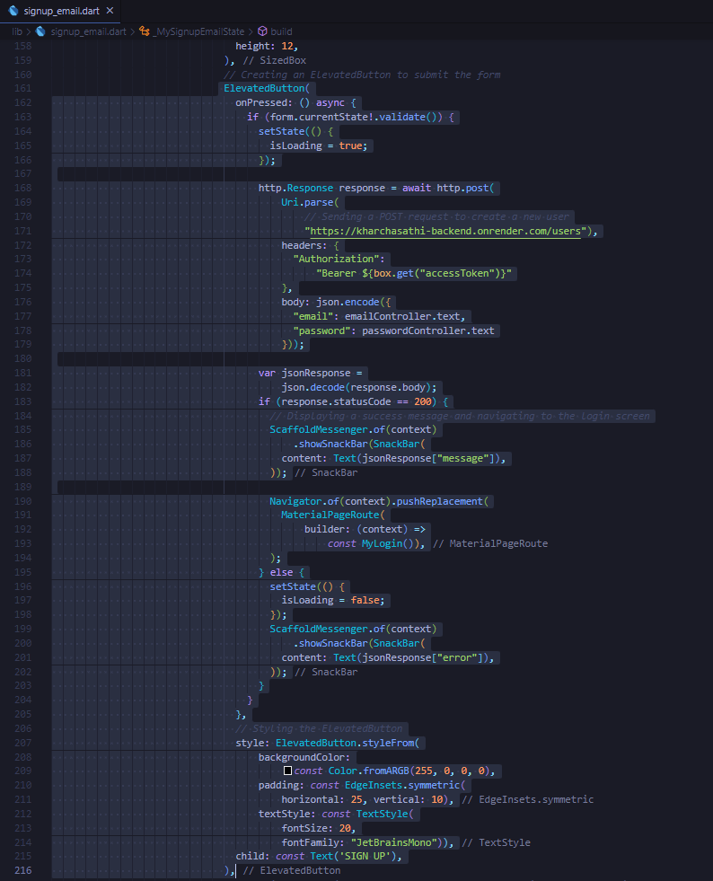
KHARCHA SAATHI
FRONT-END DEVELOPER
Nayan Raj Khanal
2227486
-Corrected the URL that fetches the data in both login.dart and signup_email.dart

Slide 13
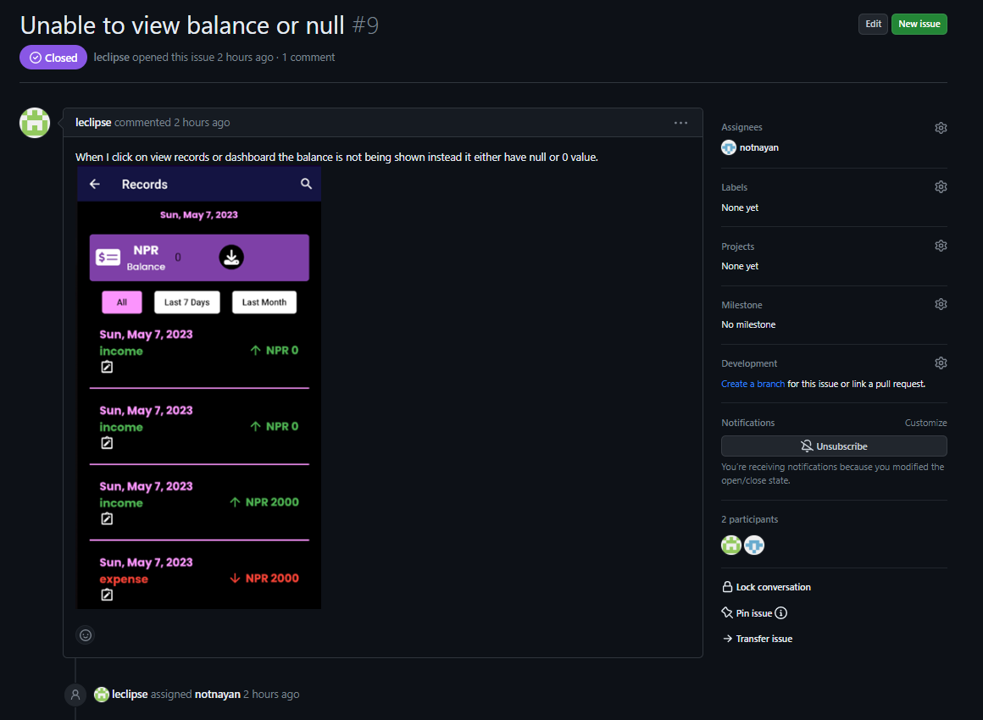
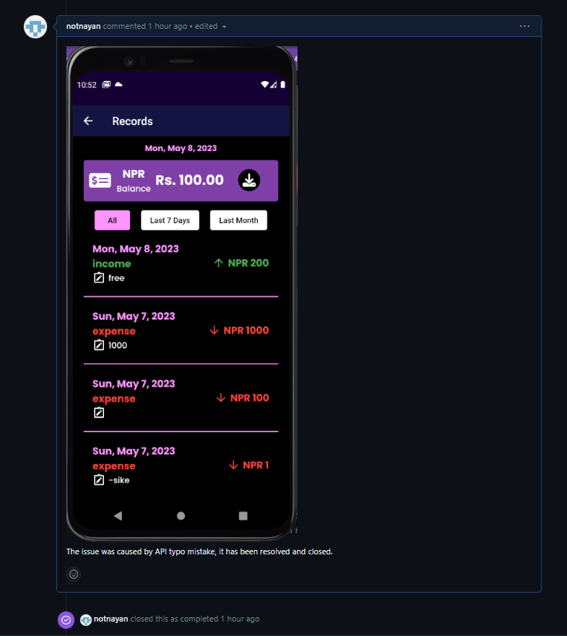
KHARCHA SAATHI
FRONT-END DEVELOPER
Nayan Raj Khanal
2227486
Issue-3

Slide 14
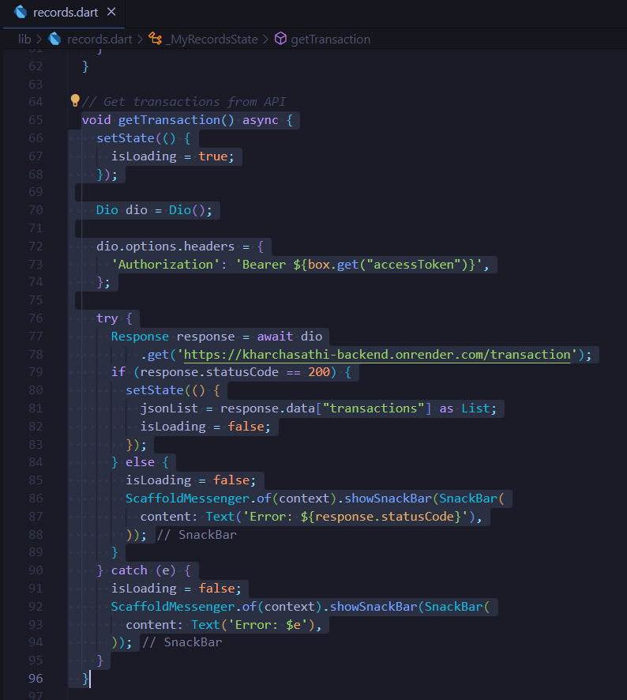
KHARCHA SAATHI
FRONT-END DEVELOPER
Nayan Raj Khanal
2227486
-Modified the function and changed the PATCH request to GET request.

Slide 15
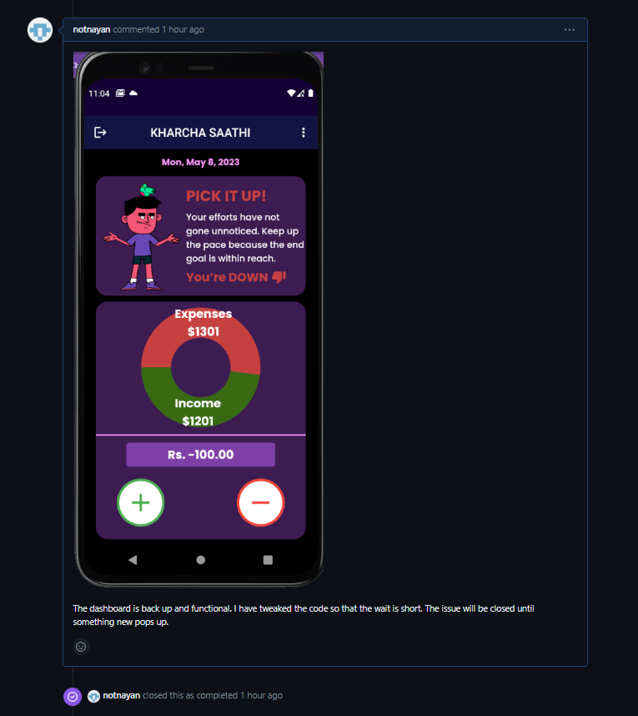
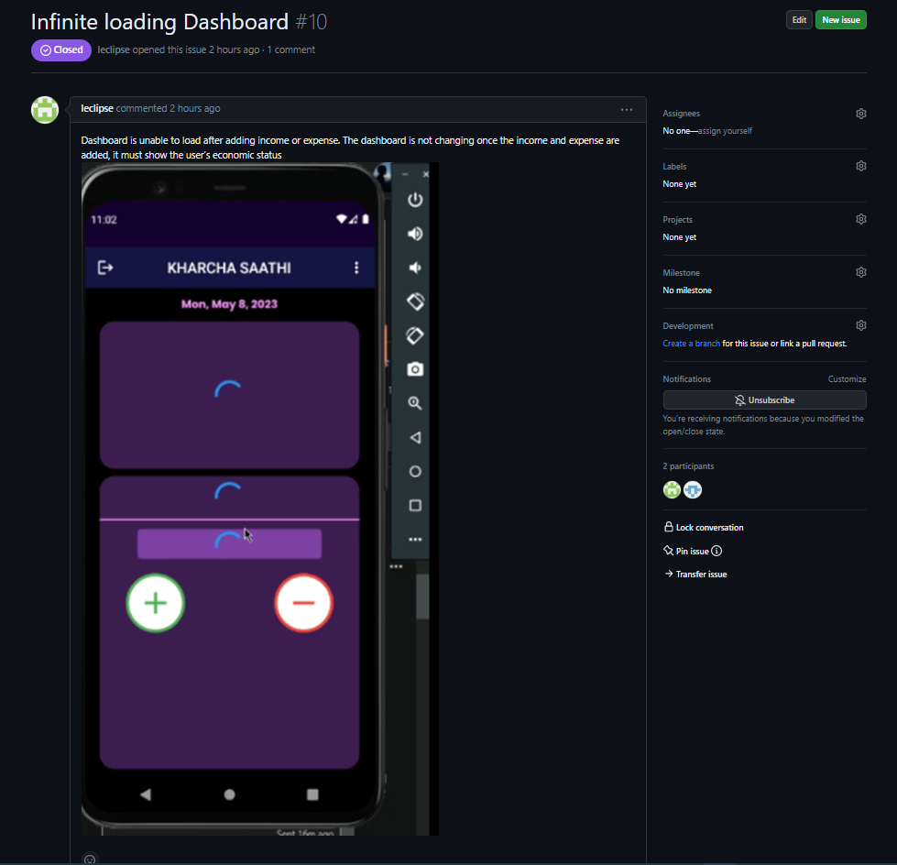
KHARCHA SAATHI
FRONT-END DEVELOPER
Nayan Raj Khanal
2227486
Issue-4

Slide 16

KHARCHA SAATHI
FRONT-END DEVELOPER
Nayan Raj Khanal
2227486
Defined two variables to store the two different containers so that the conditional statements could run quicker.

Slide 17


KHARCHA SAATHI
FRONT-END DEVELOPER
Nayan Raj Khanal
2227486
Issue-5

Slide 18

KHARCHA SAATHI
FRONT-END DEVELOPER
Nayan Raj Khanal
2227486
Changed the navigation from the Dashboard. Instead of pushReplacement method used Pop to navigate to the settings. This allows for fluid back and forth.

Slide 19


KHARCHA SAATHI
FRONT-END DEVELOPER
Nayan Raj Khanal
2227486
Issue-6

Slide 20

KHARCHA SAATHI
FRONT-END DEVELOPER
Nayan Raj Khanal
2227486
Changed "expense" to "Expense", hence if the cluster returns Expense it is red otherwise it is green.

